Slide 1
Understanding Data Videos: Looking at Narrative Visualization through the Cinematography Lens
Fereshteh Amini, Nathalie Henry Riche, Bongshin Lee, Christophe Hurter, Pourang Irani
By-
Mukul Agarwal
MS in Human Computer Interaction
University of Maryland College Park
Email: mukulagarwal7@gmail.com

Slide 2
Overview
Three part study
Qualitative examination of the narrative structures in 50 professional data videos collected from a range of reputable sources.
Workshops with experienced storytellers from cinematography, graphics design and screenplay writing were conducted in which they were observed while they created storyboards for data videos.
Analyze the workshops and determine essential features for the design of an authoring tool to enable a wide audience to create data videos.

Slide 3
Part 1:
Analysis of data videos

Slide 4
Narrative Categories
The videos were analyzed around four main narrative categories: Establisher, Initial, Peak, and Release.
Establisher (E): sequences that “provide referential information without engaging them in the actions or events of a narrative.”
Initial (I): sequences that “set the action or event in motion.”
Peak (P): sequences where “the most important things happen; the culmination of an event or the confluence of numerous events.”
Release (R): sequences that show “the aftermath of the Peak.”

Slide 5
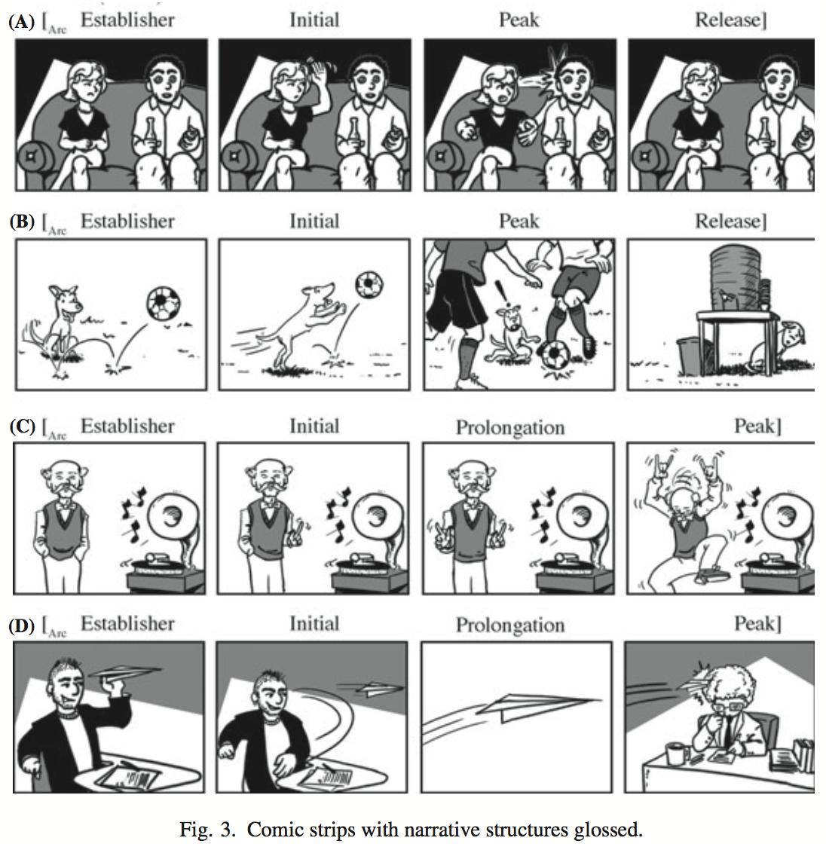
Narrative Categories
Source: Visual Narrative Structure et. al. Neil Cohn
Notes:
Establisher (E): sequences that “provide referential information without engaging them in the actions or events of a narrative.”
Initial (I): sequences that “set the action or event in motion.”
Peak (P): sequences where “the most important things happen; the culmination of an event or the confluence of numerous events.”
Release (R): sequences that show “the aftermath of the Peak.”

Slide 6
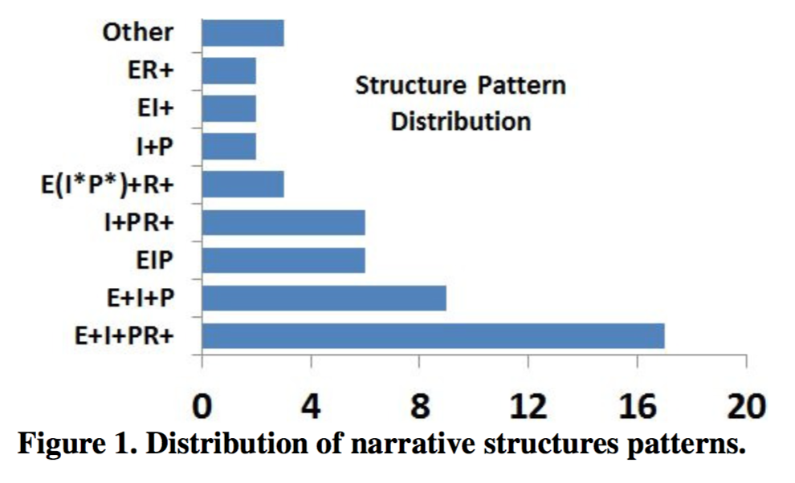
Narrative Structure Patterns
[Element+] where Element is one of {E,I,P,R} and the “+” sign indicates repetition of the preceding element.
Notes:
The most common pattern we identified in 34% of the videos is the “E+I+PR+” pattern.

Slide 7
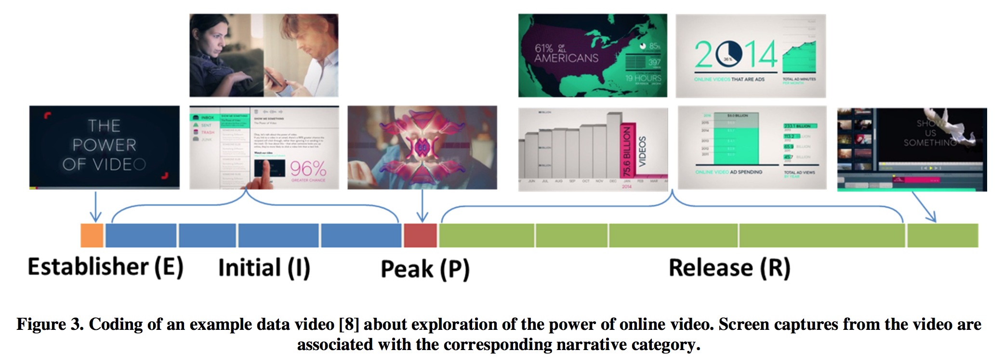
Characterizing the Content of Data Videos
Notes:
This data video is 2.07 minutes long and follows the (EI+PR+) narrative structure pattern; the combination of voice narration, video footage, data visualizations, and attention cues provides a balanced video with a powerful story about our evolving relationship with media. The Establisher unit sets up the video indicating that the video is about “the power of video”, quickly transitioning to the Initial category that includes 4 units. The first 3 Initial units each include a new fact such as stats about the rising use of video. At the beginning of the forth Initial unit, the narrator asks “why video?” followed by footage of everyday people and by reflecting on the information already presented, builds the tension for the Peak unit that answers the question in one sentence. The Peak ends with drastic audio and animation effects to grab the viewer’s attention. The video then continues by presenting more facts that supports the answer given in the Peak. This is done through 4 Release units, all of which include data visualizations (i.e., bar, pie, line, and stacked charts, and a map). Animated charts, highlighting a single bar in the bar chart, and sequential change of the year range are amongst attention cues used within the data visualizations. The fifth and last unit in the Release includes a take away message which asks the viewers to create videos: “Show Us Something”.

Slide 8
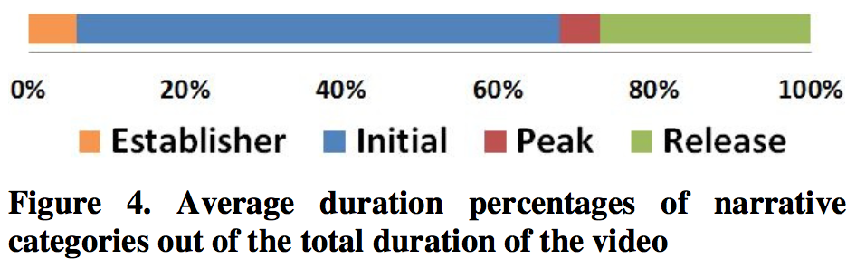
Composition of Narrative Categories
Initial category is the most prominent in data videos implying that the structures in the data videos break away from the traditional narrative structures in which the Initial category is shorter in duration stretching up to the middle of the narrative where the Peak is.

Slide 9
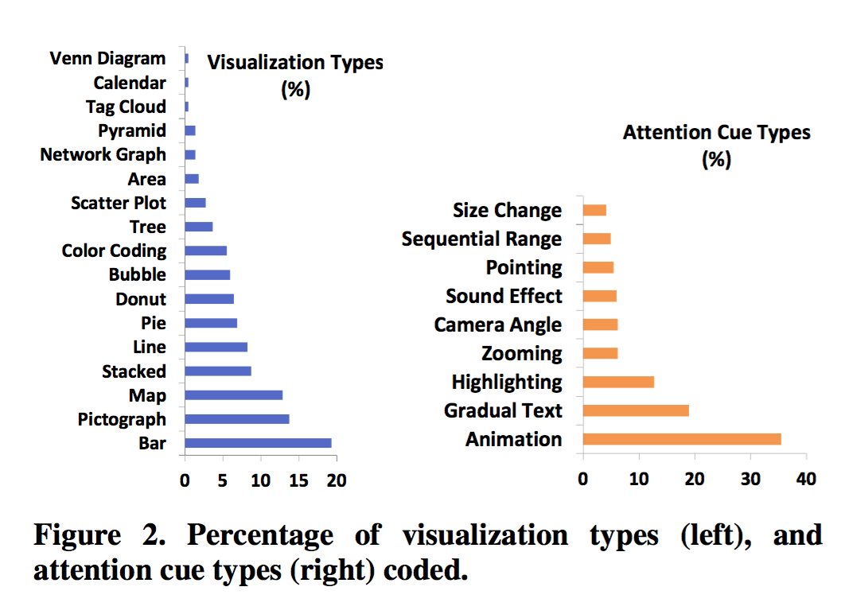
Characterizing the Content of Data Videos
Content of data videos is described along the two identified dimensions: Data Visualization Types and the types of Attention Cues.
Notes:
the average duration of a data video was found to be 3 minutes (ranging from 1 to 7.5 minutes),
the average number of data visualizations presented is six (ranging from 1 to 19 visualizations).
On average, 48% of the total duration of a data video is dedicated to data visualizations.
However, despite this high content dedicated to visualizations, 72% of the data videos tend to rely on only 5 different types of visualizations on average.
The top three most commonly used attention cues were animation, appearing/disappearing, and highlighting.

Slide 10
Part 2
ANALYSIS OF STORYBOARDING PROCESS

Slide 11
Methodology
A series of workshops were designed to observe how professional storytellers create data video storyboards.
13 experienced storytellers (5 female and 8 male)
Five sessions with pairs having the same background and three sessions with a single participant.
Participants were provided with a set of facts and visualizations to select from and create a data video storyboard.
Data of general interest on marriage and divorce was provided.
Notes:
data video professionals were hard to find thus they looked for professionals from other fields who created stories

Slide 12
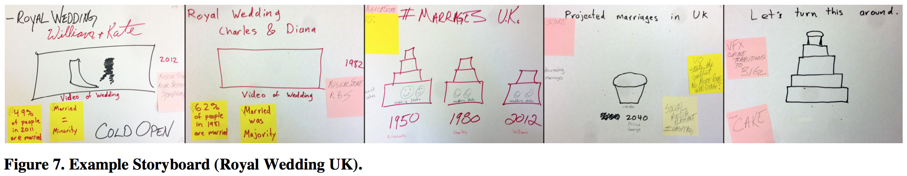
Procedure
The session was initiated with a presentation of the study and a collection of demographics. Participants watched two data videos and were shown a hand-drawn storyboard to illustrate the type of expected output.
Notes:
The first panel features a video clip from William and Kate’s royal wedding and voice over stating that marriage rates were about 49% in 2012. The next panel features a video clip from Charles and Diana’s wedding, 20 years earlier with the voice overstating that marriage rates were 62% then. The third panel stars a bar chart, representing the trends in marriage rates over by different heights of wedding cakes. The fourth panel shows a cupcake representing the projected low rates 30 years from now. The final panel invites the viewer to turn this trend around, featuring an animation where cake layers are added below the cupcake.
The experimenter instructed participants to build their story from the data given to them, not allowing them to search or make up new information. The experimenter also informed the participants that data visualizations were provided as examples only and they were encouraged to design or alter the visual representations to best fit their story.

Slide 13
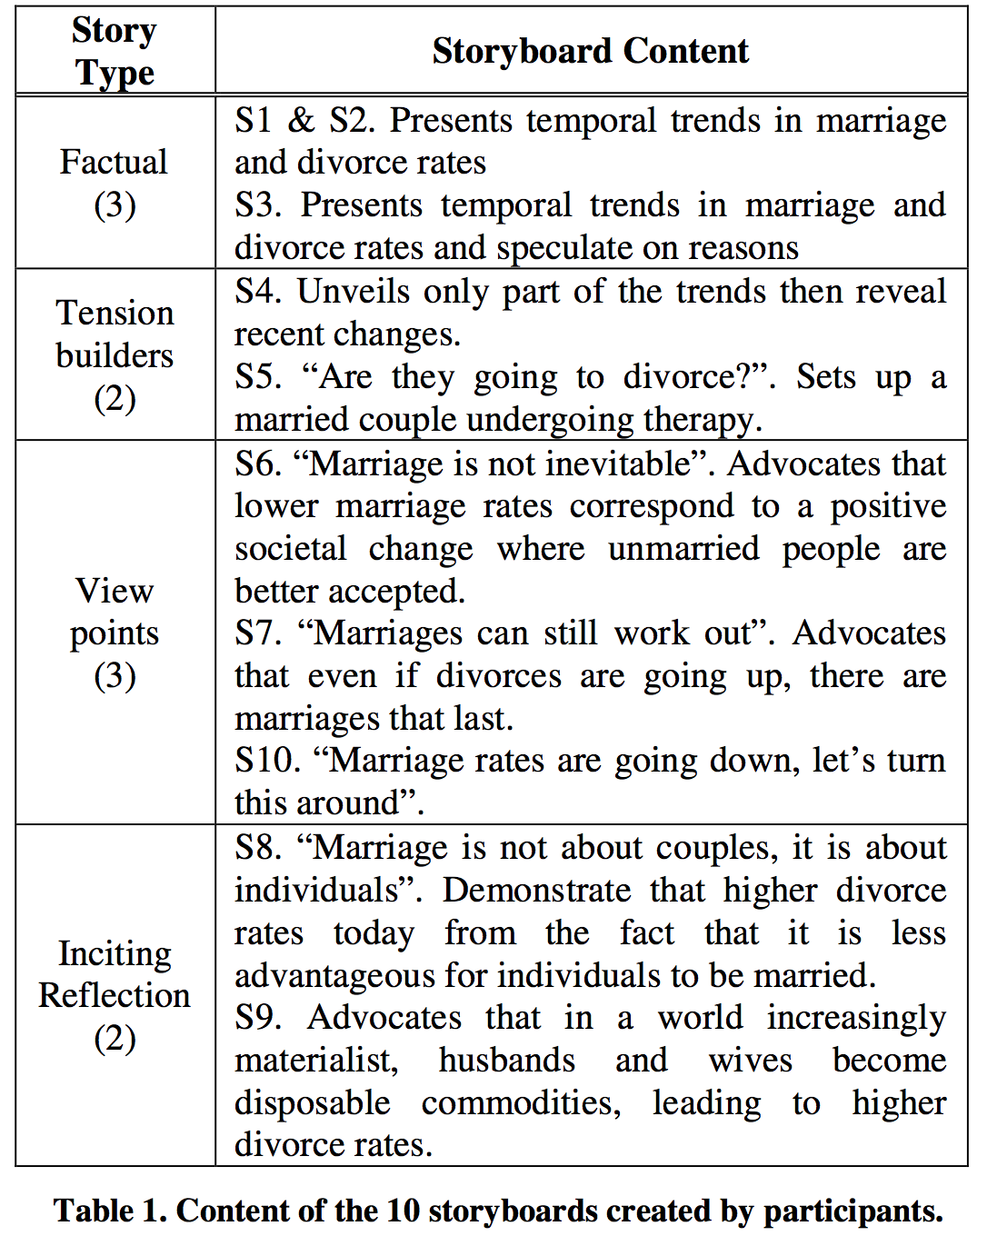
Results
EI+
E+I+P
Notes:
We collected 10 storyboards and recorded over 24 hours of video from the eight storyboarding sessions we conducted.
All finished storyboards could be matched to narrative structure patterns we identified in study 1. For example, factual stories employed an EI+ narrative structure without any peak, but rather going over a subset of facts in order. In contrast, the storyboards building tension, or reflecting participants’ viewpoints featured a peak towards the second third of the storyboard, utilizing E+I+P, one of the most common narrative structure pattern.
These are the 10 storyboards we collected and segmented into different structures
Strategies to engage viewers
the degree of personification of the story. Participants in 4 sessions explicitly discussed introducing recurrent human figures or topic-related recognizable objects (e.g., wedding ring or cake) to raise the degree of personification of the video and help the viewer relate to the message and project themselves in the video.

Slide 14
Characterizing the Storyboarding Process
Participants engaged in four main activities:
reading and interpreting data
selecting data and corresponding visualizations
crafting the narrative structure
integrating strategies to engage viewers
Notes:
2. This process was closely coupled with the read and interpret process. It is also interesting to note that a common criterion for selecting data visualizations was its complexity and the estimated low visual literacy of a broad audience.

Slide 15
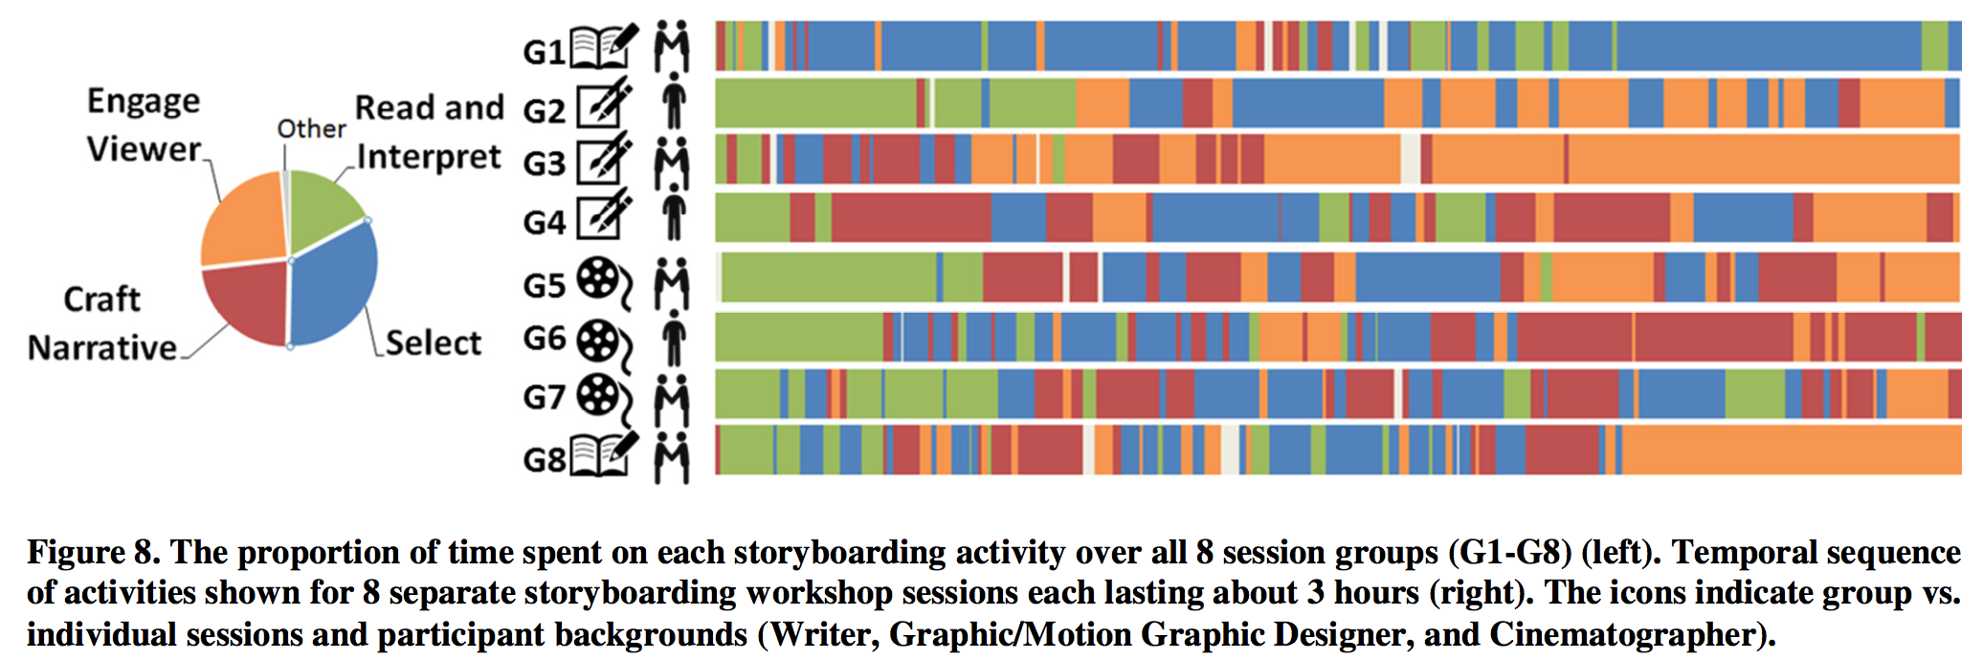
Characterizing the Storyboarding Process

Slide 16
Observations
Creation process was non-linear. Participants in all eight sessions alternated between different set of activities.
Process was iterative. Participants crafted an end-to-end narrative structure with a first set of data and visualizations and iteratively added to their storyboards.

Slide 17
Part 3 Design Recommendation for a data video authoring tool for novices
Notes:
Design implications for a data video authoring tool for novices.
Data Video Content

Slide 18
Visualization types
Most videos rely on only a few types of well-known visualizations (e.g. bar charts, pictographs, and maps). Limit novice designers to a small set of commonly used visualization types but give them the flexibility to customize their rendering options and color palette.
Pictographs are heavily present in data videos and should be made available in the data video authoring software.

Slide 19
Attention Cues
Along with camera effects, highlighting, and text animations data video authoring tools should also provide support for voice narration and soundtrack which are present in almost all data videos.
Guide authors into using an explicit narrative structure for their videos by giving hints on the type, frequency and strength of attention cues they can use.

Slide 20
Narrative Structure
Identifying different building blocks of a narrative (Establisher, Initial, Peak, and Release) could play a central role in a data video authoring tool. Making these building blocks explicit and suggesting the types of content commonly used in them, as well as their duration, could streamline the process.
An authoring tool with storyboarding facilities based on rapid sketching may help in capturing the authors’ initial vision and allow iterative refinement. Such a tool can also integrate features to enable authors to easily go back and forth between different storyboarding activities.

Slide 21
Discussion and Limitations
The study includes analysis of a limited corpus of videos.
Does not assess their actual quality, whether or not they comply with best design practices, or the level of engagement of their audience.
Does not includes participants specializing in data visualizations in their workshops.

